Slide 1
Introduction
Human plasma contains many proteins which are of great medical importance.
Plasma fractionation enabled the widespread use of medical products that are extracted from human plasma.
Pharmaceuticals of animal or human origin have the risk of viral contamination.
1980-1990 transmission of HIV and HCV by plasma derived pharmaceuticals caused serious problems.
→ It is therefore a requirement : …to provide evidence that the production process will effectively inactivate/remove viruses…. (European Medicine Agency CPMP/BWP/268/95)

Slide 2
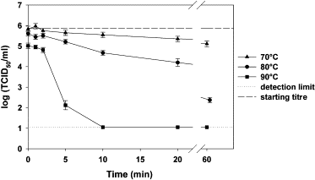
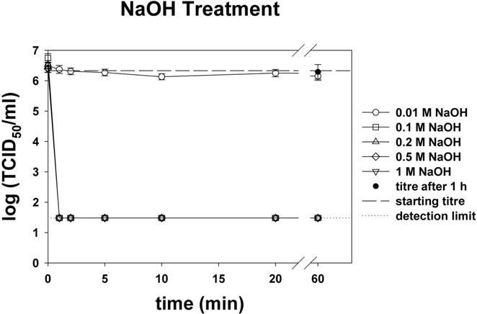
Mechanisms of virus reduction
We can distinguish three different mechanisms to reduce viruses:
Inactivation (pasteurization, pH treatment)
Elimination based on size
Partitioning
Temperature treatment
Parvoviruses = worst case model viruses
pH treatment
Small, non-enveloped
Highly robust and resistant to physico-chemical treatment
Boschetti N, Wyss K, Mischler A, Hostettler T, Kempf C. Stability of minute virus of mice against temperature and sodium hydroxide. Biologicals. 2003 Sep;31(3):181-5.
Notes:
CHALLENGE

Slide 3
Virus reduction by partitioning
Plasma fractionation includes the following processes:
Precipitation and subsequent separation of solid and liquid phase by e.g. depth filtration
Chromatography
Protein solution (pooled plasma)
Protein suspension / Albumin-solution
Specific conditions
Temperature
Ethanol concentration
Ionic strength
pH
Model viruses investigated:
CPV and MVM
Log reduction factors:
4.1 1.9
filtrate
filter cake (waste fraction)
Observation: CPV is precipitated 100x more efficiently than MVM!

Slide 4
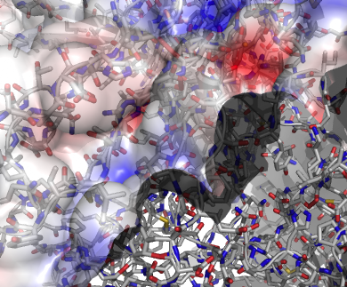
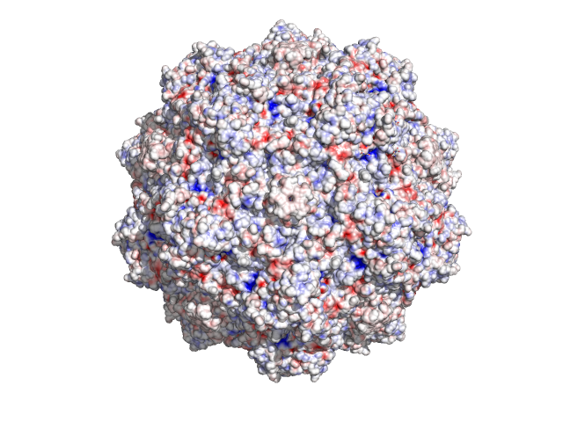
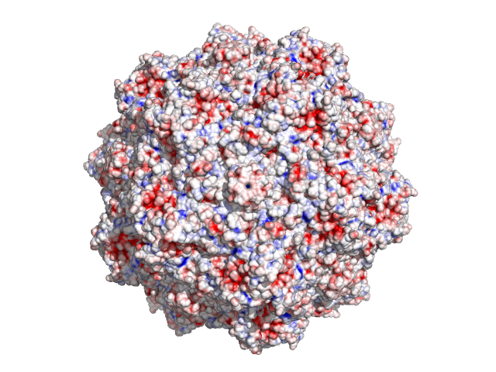
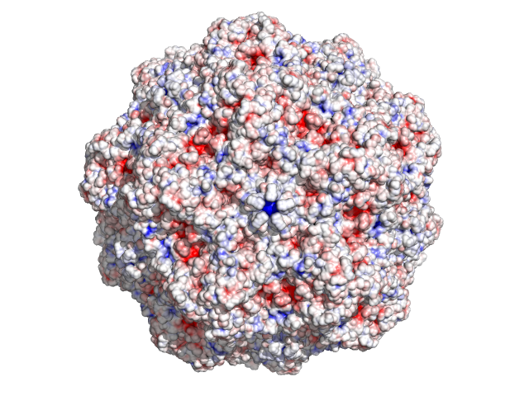
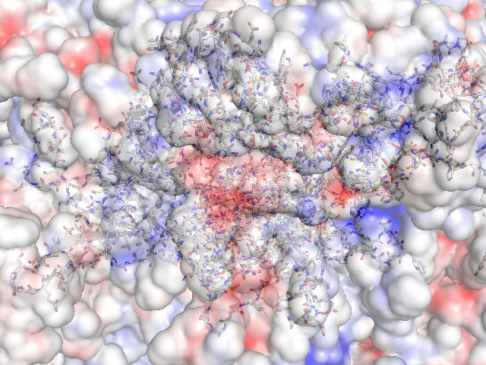
Superposition of both viral surfaces and calculation of the difference in electrostatic surface potentials.
Variations in surface electrostatics might cause the different behaviour of those viruses in precipitation experiments.
MVM is more negative than CPV.
MVM is more positive than CPV.
Minute virus of mice (MVM)
+ 180 e⁻
Canine parvovirus (CPV)
0 e⁻
The Calculation is based on the adaptive Poisson-Boltzmann Solver (APBS) that was run in Pymol as a plugin.
Net surface charge
Notes:
Viral Capsid protein on Atomic level is aligned on the difference plot

Slide 5
Structure of MVM
MVM is composed of two structural capsid proteins VP1 and VP2. VP2 is a splice variant of VP1 that is shorter at its N- terminal sequence. The 142 aa extension of VP1 is termed VP1 unique region (VP1u).
→ A mutation within the common region of VP1 and VP2 will be represented 60x with respect to the whole capsid!

Slide 6


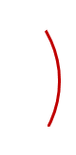


Experimental Approach
Computer model
1. Site-directed mutagenesis
2. Transfection of susceptible A9 mouse fibroblasts
Infectious clone of MVM
Mutated clone of MVM
MVM mutants
2. Transfection of susceptible A9 mouse fibroblasts
3. Testing biochemical properties of the mutants and comparison with WT MVM
Ion exchange chromatography
Capillary electrophoresis
Isoelectric focusing (IEF)
Precipitation studies
WT MVM

Slide 7
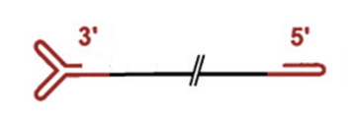



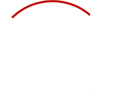


Construction of an infectious clone of MVM
Native MVM genome
Left- handed ITR
Coding MVM Sequence
Right- handed ITR
Complete MVM genome within a cloning vector

Slide 8
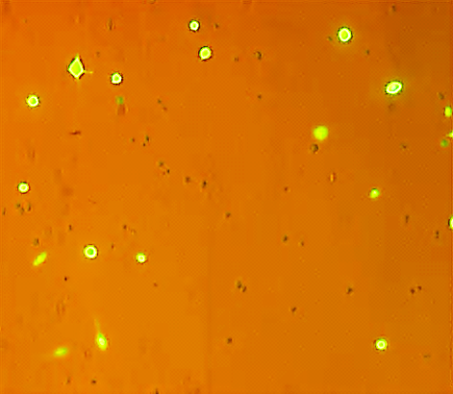
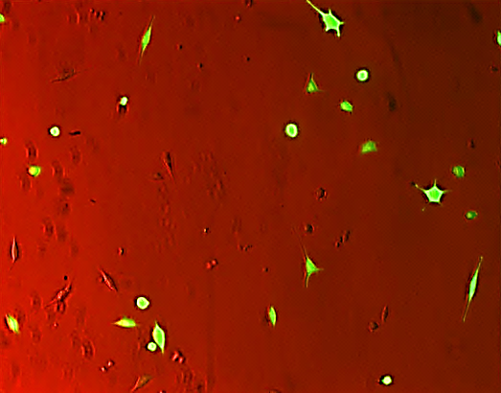
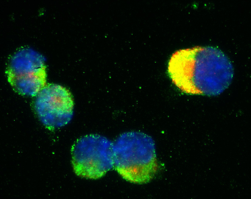
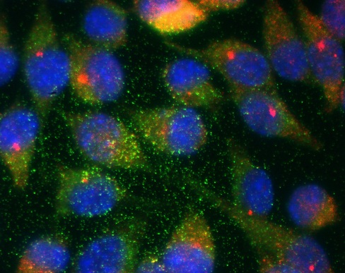
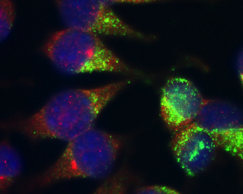
Transfection / Infection
Transfection of A9 mouse fibroblasts with a GFP control plasmid
25 %
50 %
1 dpT
2 dpT
5 x 10⁶ cells
5 ug DNA
5 x 10⁶ cells
10 ug DNA
5 x 10⁶ cells
20 ug DNA
10⁷ cells
20 ug DNA
DAPI
Intact MVM Capsids
Viral proteins
2 dpT
4 dpT
5 dpT

Slide 9
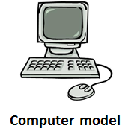
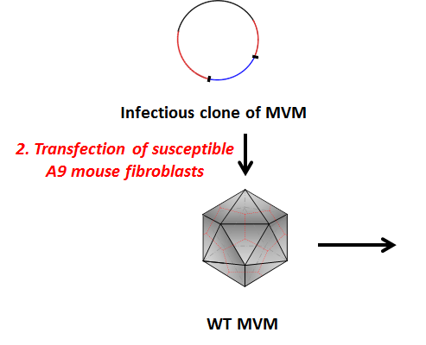
Outlook
1. Site-directed mutagenesis
2. Transfection of susceptible A9 mouse fibroblasts
Mutated clone of MVM
MVM mutants
3. Testing biochemical properties of the mutants and comparison with WT MVM
Ion exchange chromatography
Capillary electrophoresis
Isoelectric focusing (IEF)
Precipitation studies

Slide 10

It is a pleasure to thank those who make this work possible…
Christoph Kempf
Carlos Ros
Remo Leisi
Silva Quattrocchi
Nico Ruprecht
Marcus von Nordheim
and for financial support…
…I am very grateful!!!
Acknowledgements
Prof. Jose Maria Almendral
Dr. Michele Cascella
Dr. Gregory Gannon
PD Dr. Achim Stocker
Dr. Mario Bumann

Slide 11
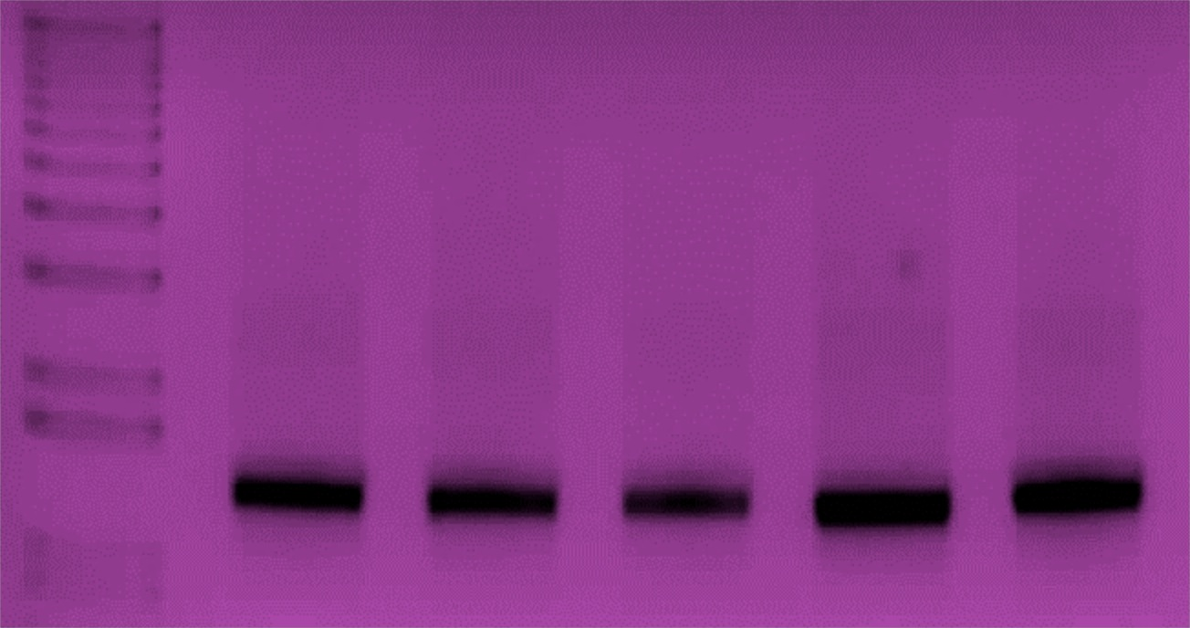
Verification of CSL Mutants
PCR amplification of the coding region for VP2 with the following primers:
Name: C VP2 ampl. F
Sequence: 5’-ATCAGTCAAAGGCAACATGG-3’
Name: C VP2 ampl. R
Sequence: 5’-GCTCTAAGTTTTGCTCTCATGG -3’
Amplified region: 1341 nt’s
Native MVM
CSL 1.1
CSL 2
CSL 4.1
CSL 5
4’100
3’000
2’000
1’650
1’000
850

Slide 12
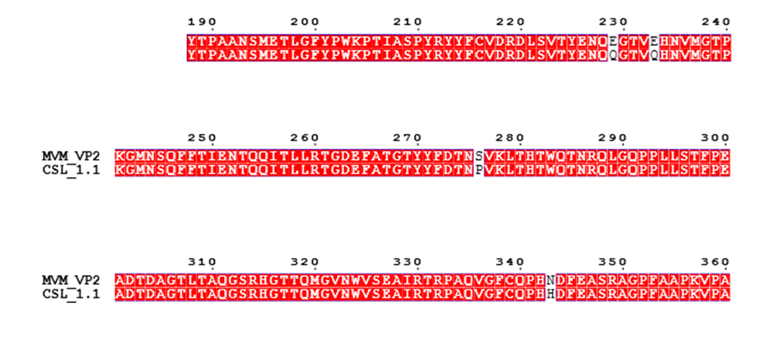
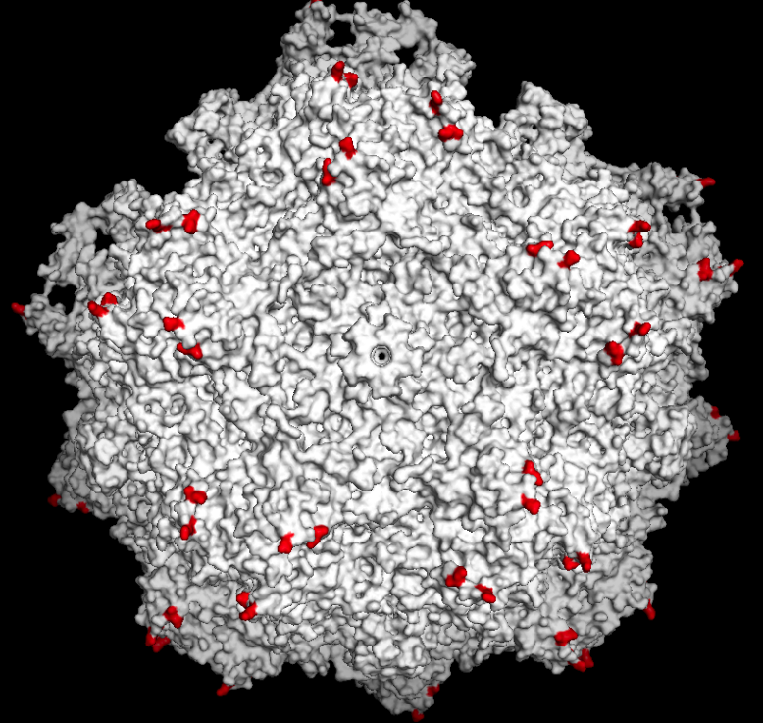
Mutant 1.1: E229Q/E233Q

Slide 13
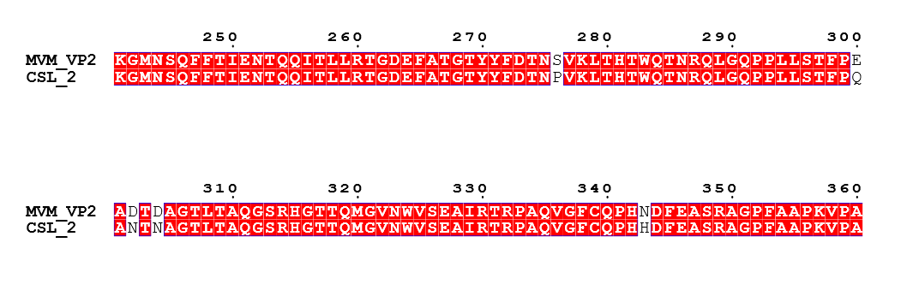
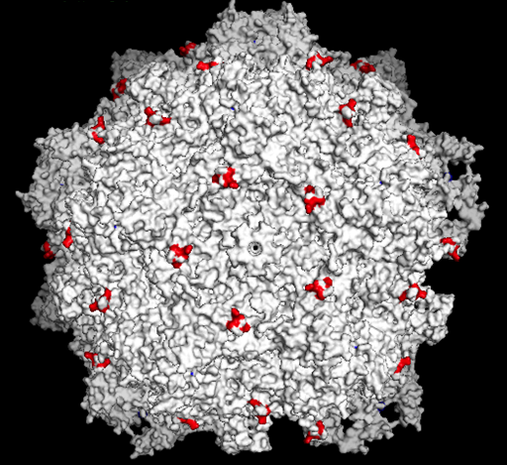
Mutant 2: E300Q/D302N/D304N

Slide 14
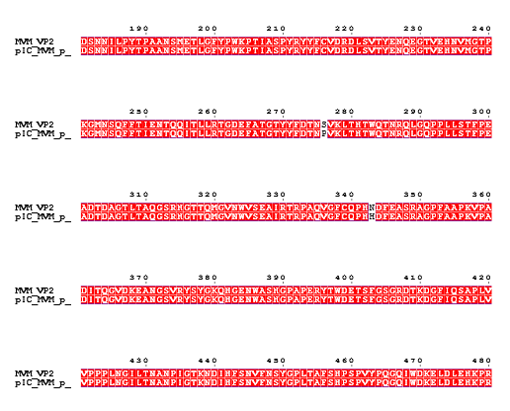
pIC_MVM(p)

Slide 15
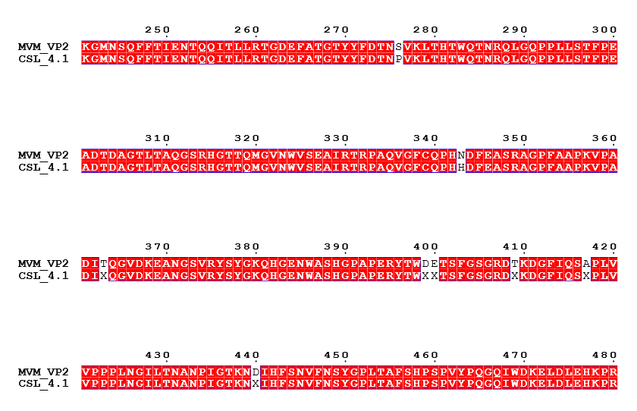
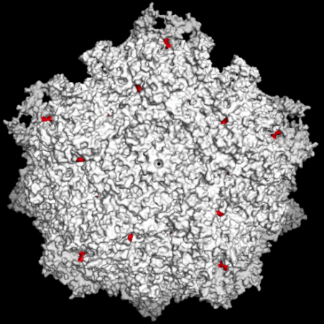
Mutant 4.1: D399N/E400Q

Slide 16
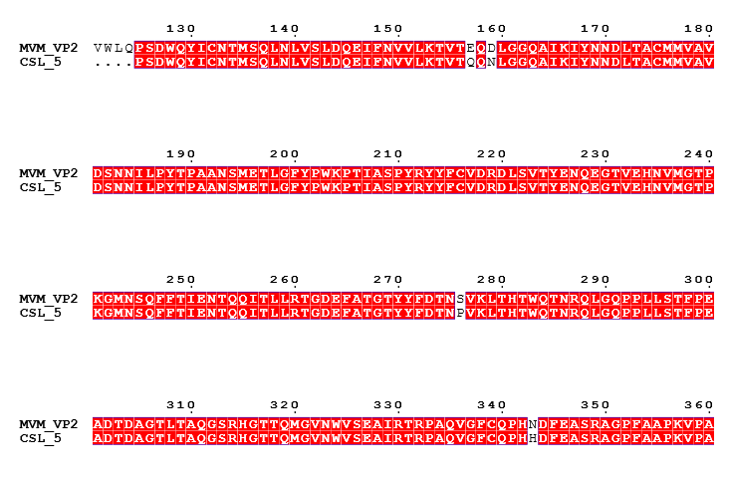
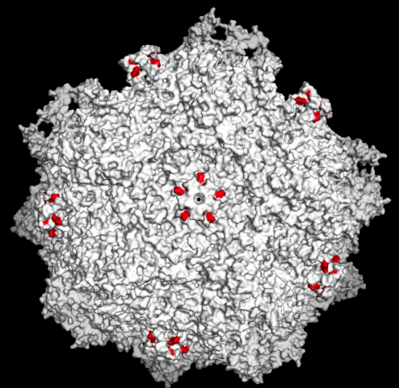
Mutant 5: E157Q/D159N

Slide 17
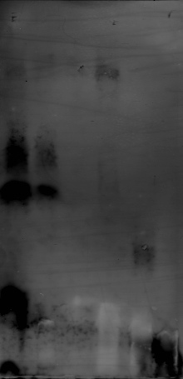
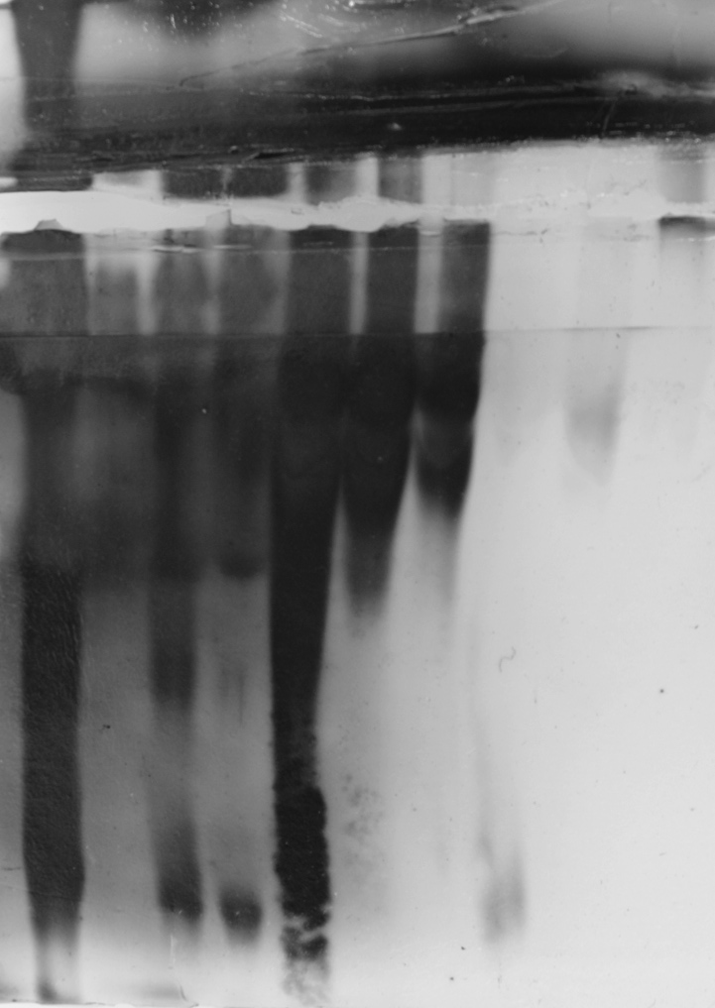
BSA
Carbonic Anhydrase
Amyloglucosidase
10 uL IEF Marker
20 uL IEF Marker
pI
Carbonic Anhydrase 100 ng
10 uL IEF Marker 1/10
10 uL IEF Marker
5 uL IEF Marker 1/10
FC
EC
BSA 10 ng
Amyloglucosidase
6
BSA 100 ng
5.9
pI
5.3
5.2
4.7
5.9
4.5
5.3
5.2
4.2
4.7
4.5
3.8
3.6
4.2
3.8
3.6

Slide 18
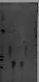
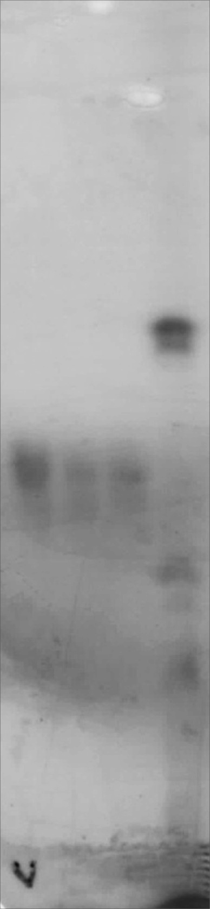
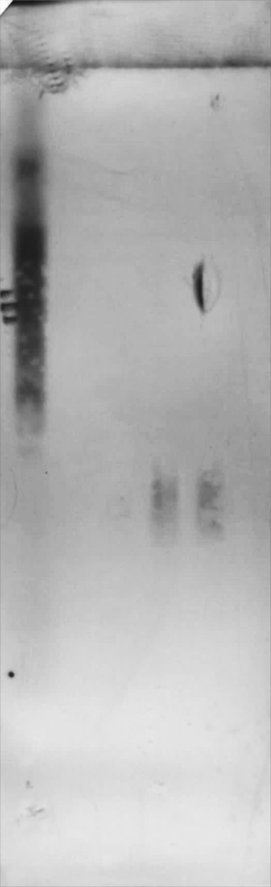
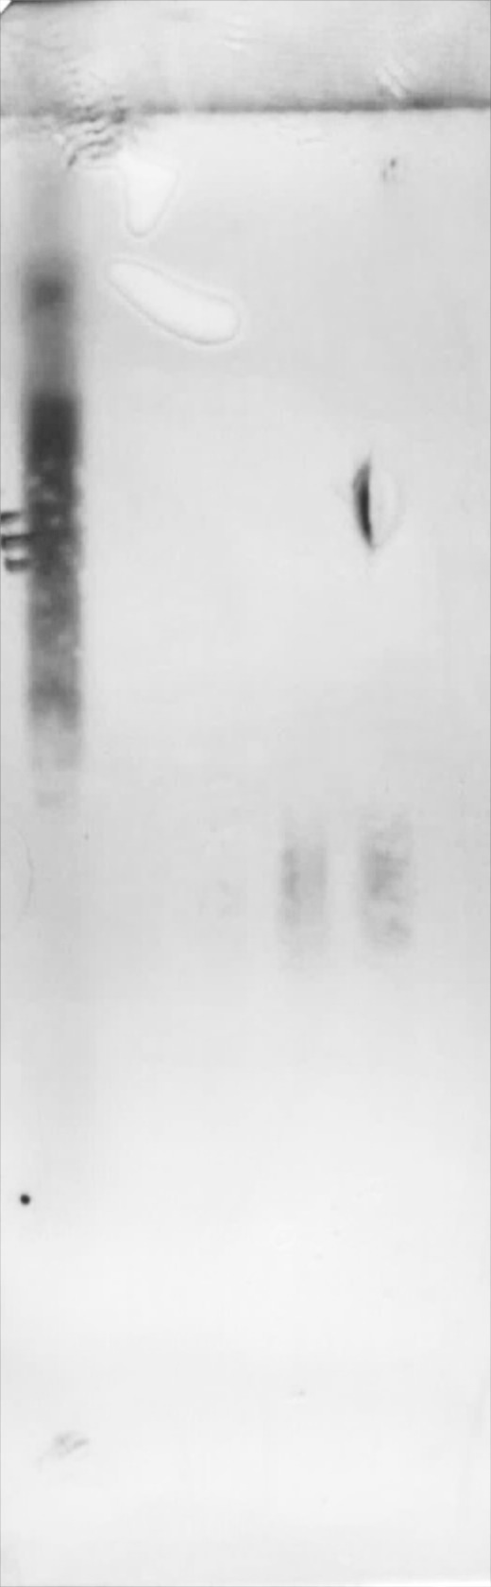
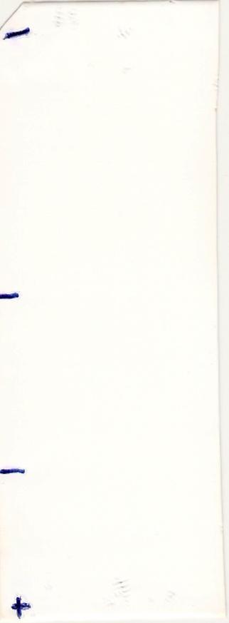
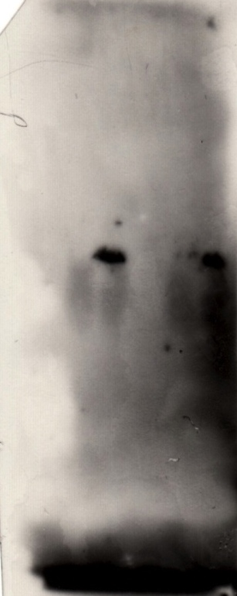
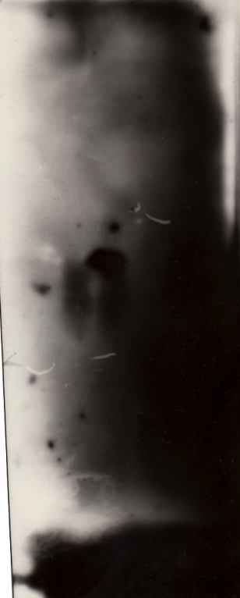
14. 05. 14
23. 05. 14
26. 05. 14
pI
pI
6
5.9
5.3
6.0
5.2
5.3
4.7
5.2
4.7
Sample Application
4.5
4.5
4.2
4.2
Methyl Red
3.8
60 ug
90 ug
120 ug
20 uL Ladder
60 ug
90 ug
120 ug
20 uL Ladder
60 ug
90 ug
120 ug
BSA
BSA
BSA
10⁸ EC
10⁸ FC
10⁹ EC
10⁹ FC
10⁸ EC
10⁸ FC
10⁹ EC
10⁹ FC

Slide 19
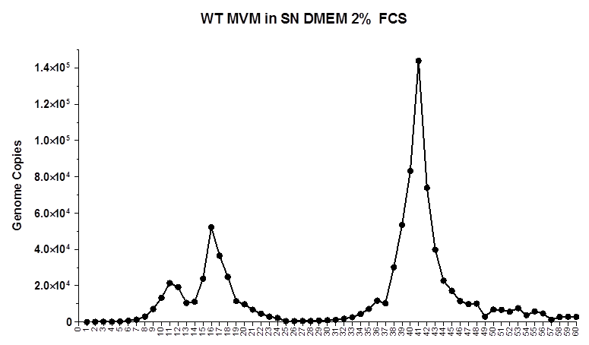
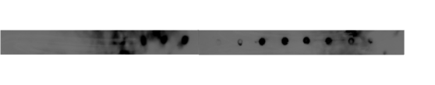
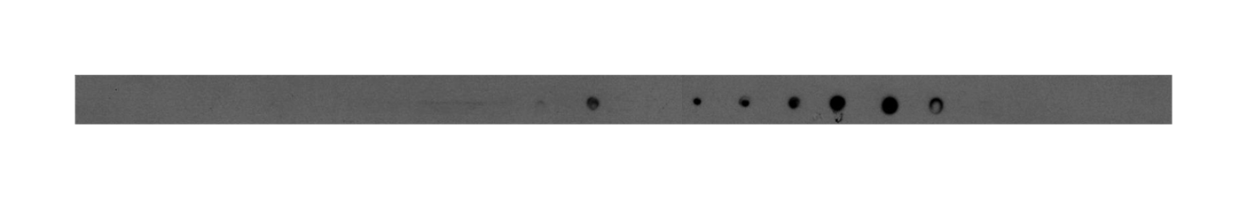
Anti Capsid (B7 mAb)
Anti N-VP2

Slide 20
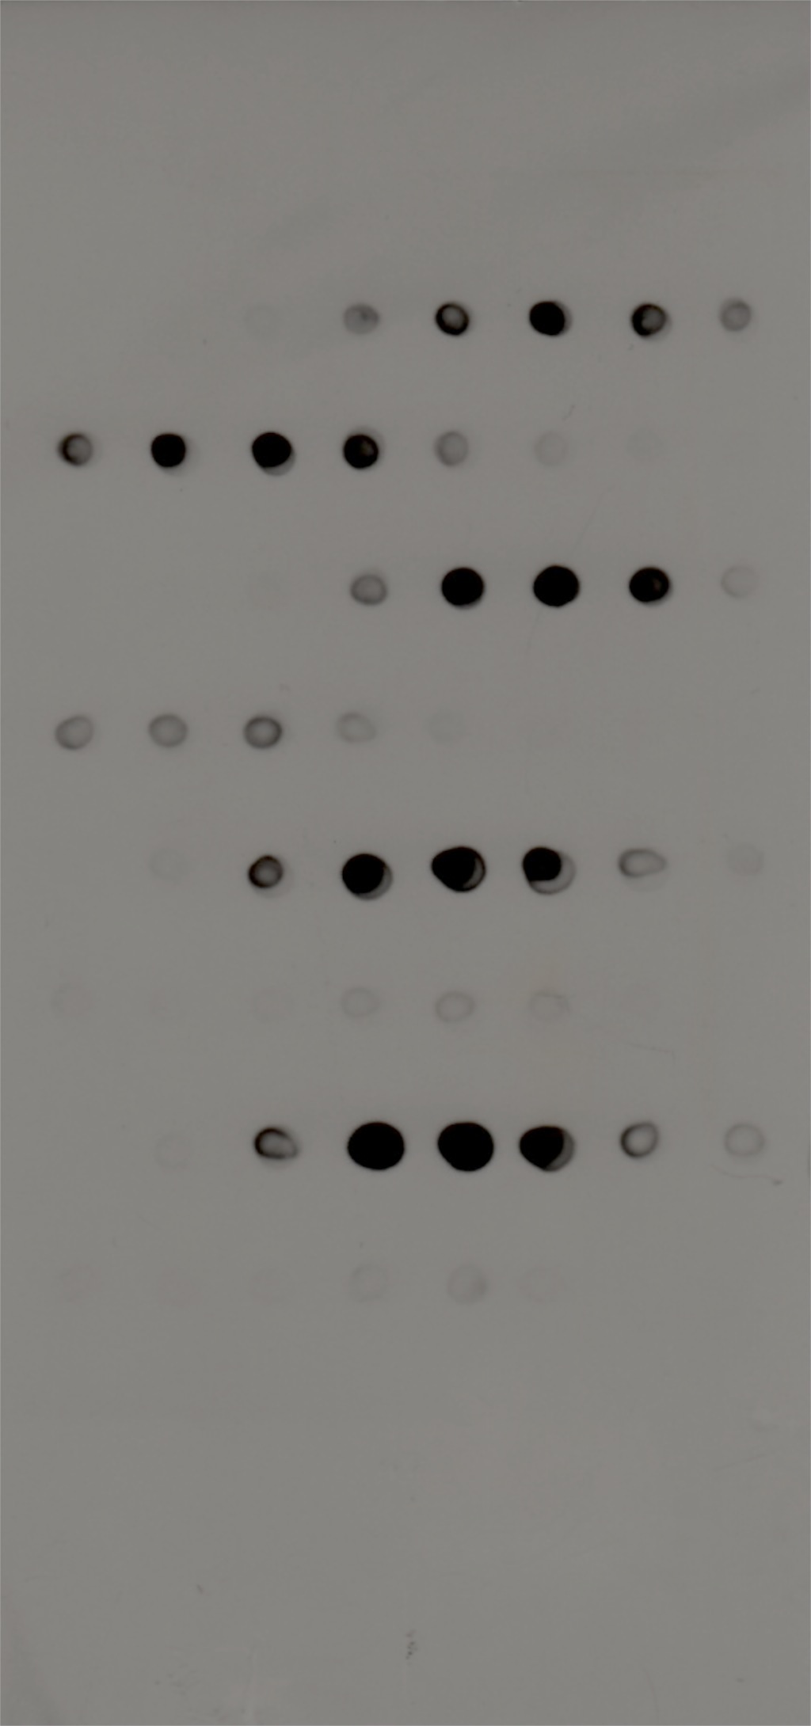
N-VP2

